Slide 1
25-52
320C 15min 40N
Largepads, No cleaning

Slide 2
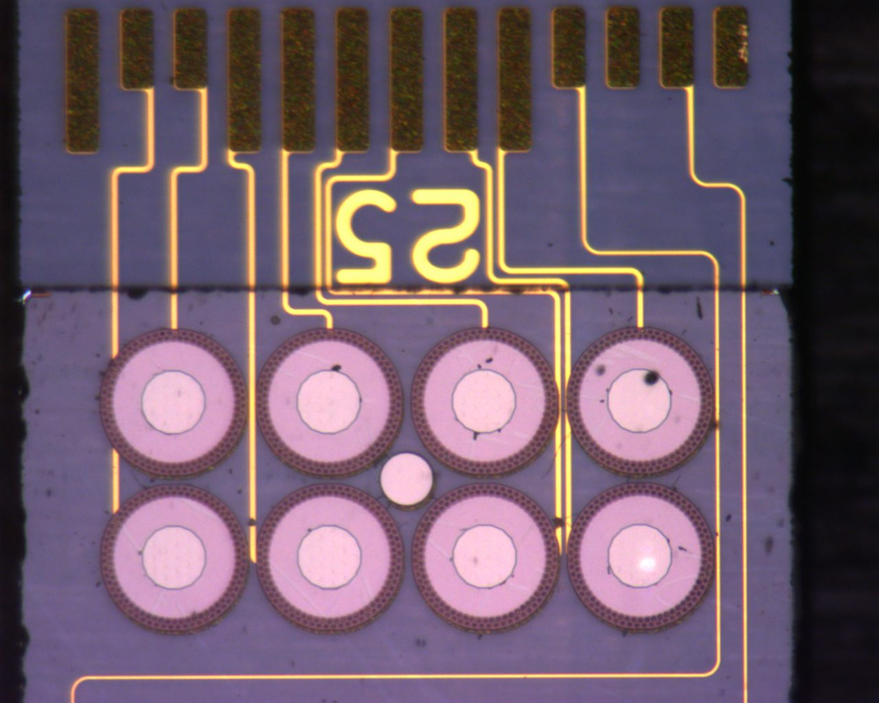
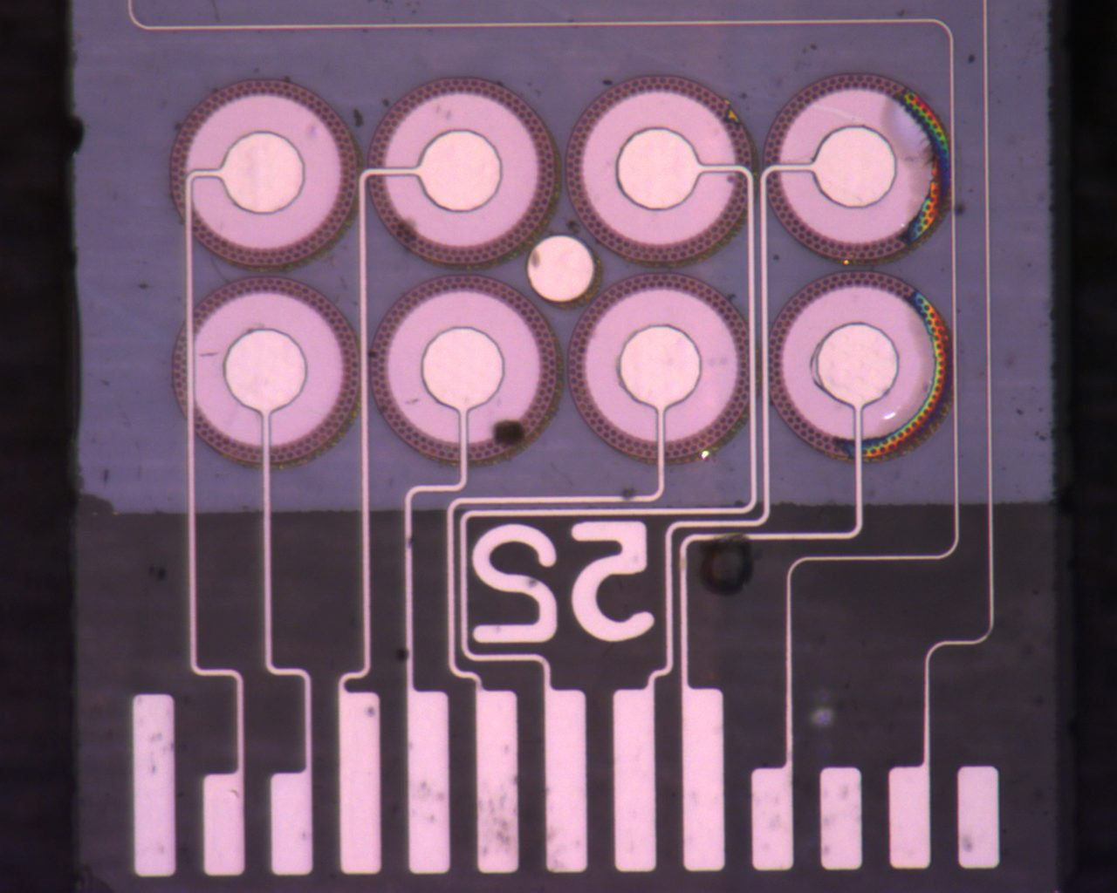
52 Backside
Post Bonding
Notes:
Mass of glass:
2.25 * 20 * 0.5 * 1e-9 * 2.23

Slide 3
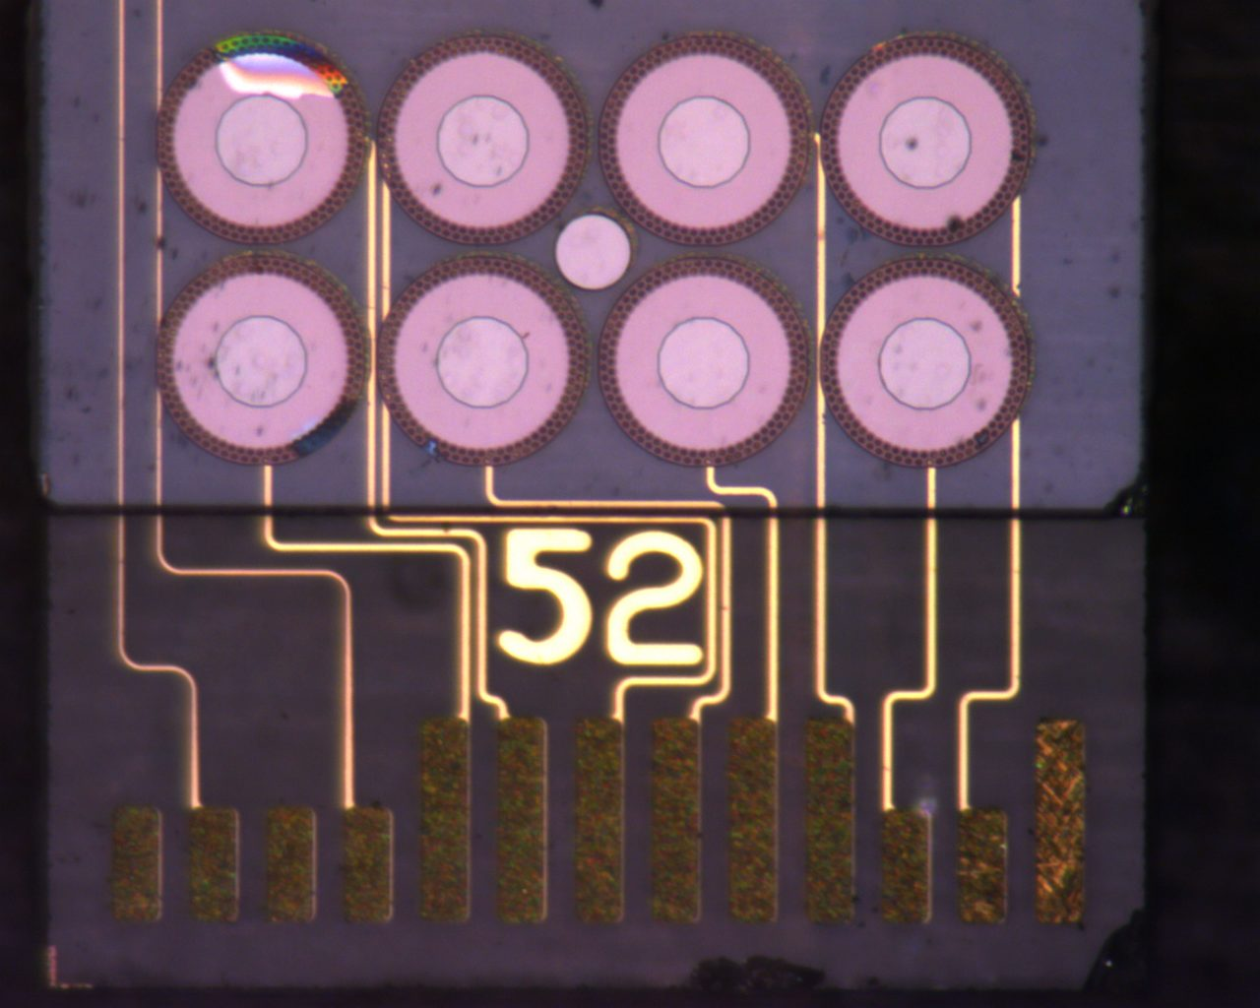
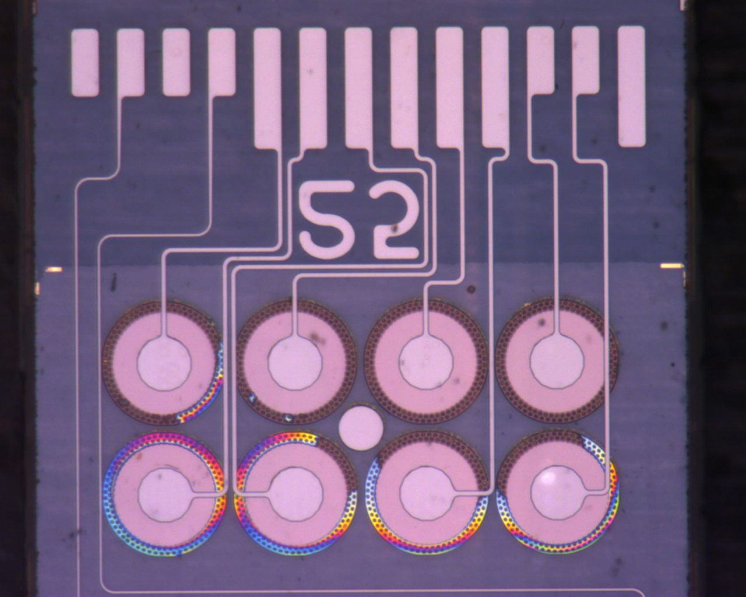
25 Backside
Post Bonding

Slide 4
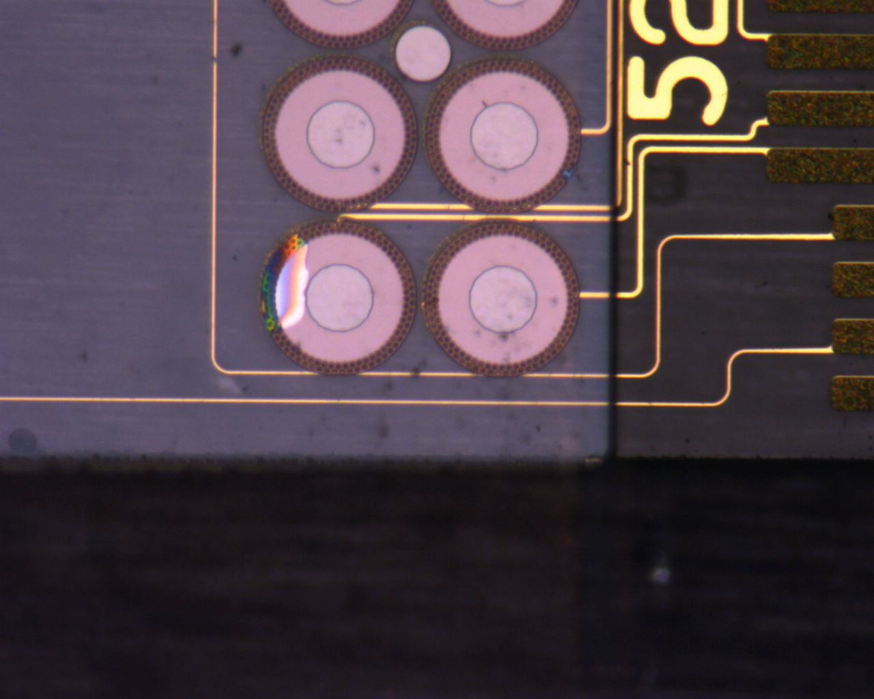
Delamination between titanium back and glass strip

